Slide 1
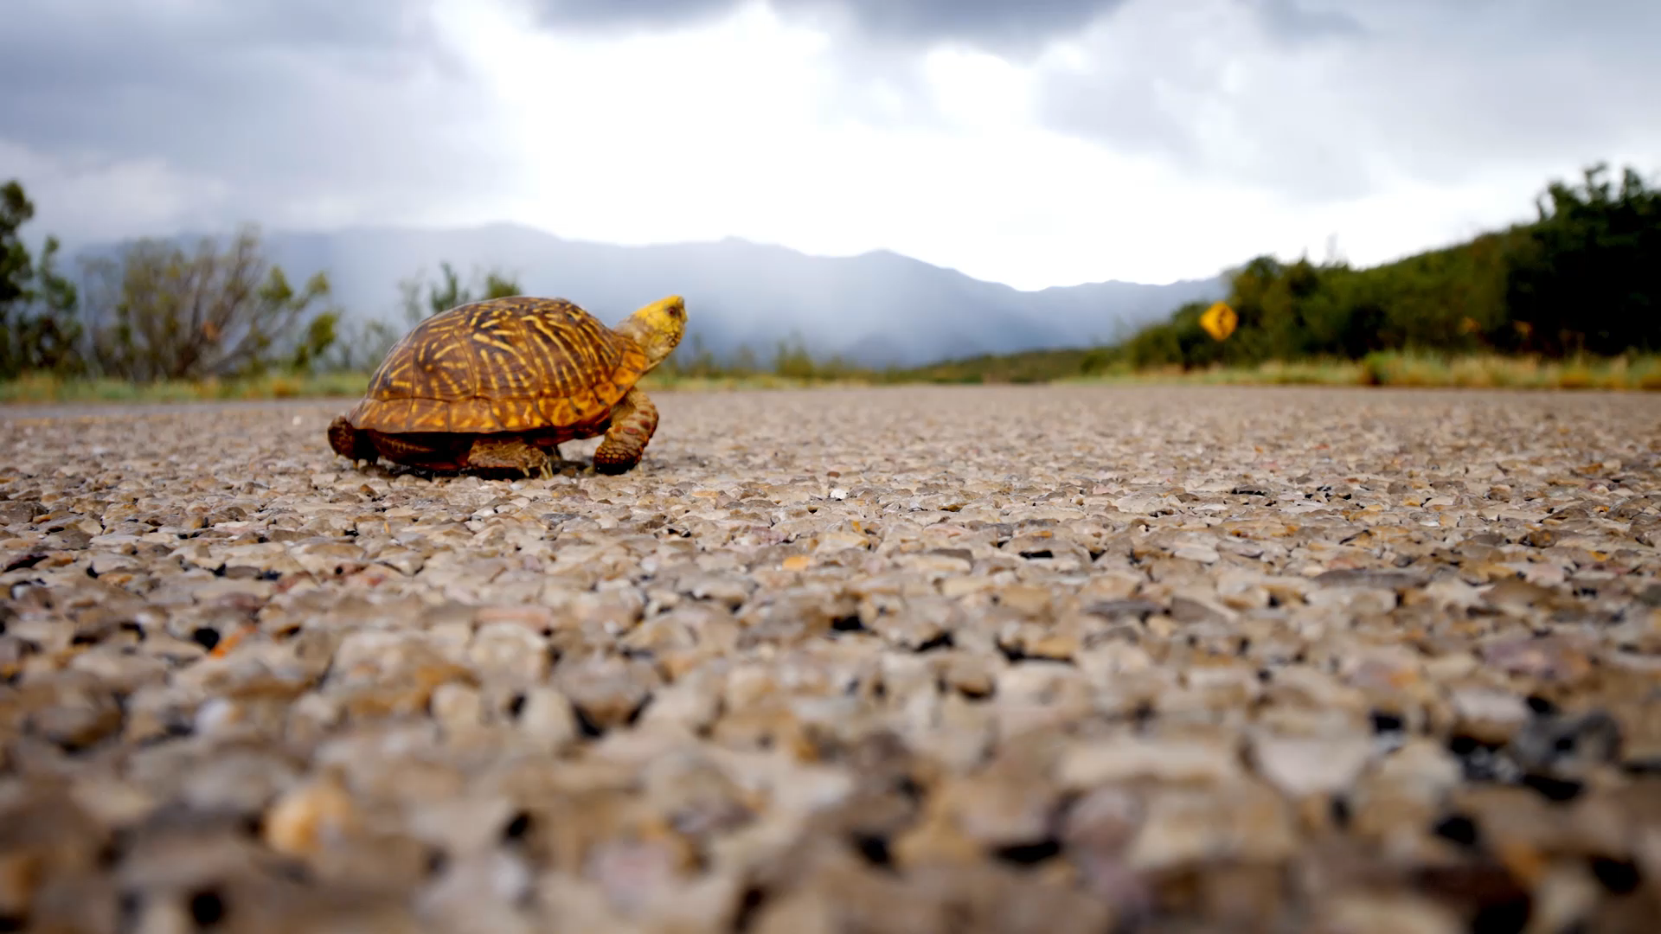
Safety improvement measures for Arizona Roadways

Slide 2
Highway Safety Improvement Program (HSIP)
In 2012, the Arizona Association of County Engineers working for the US Department of Transportation prepared a proposal to launch the HSIP.

Slide 3
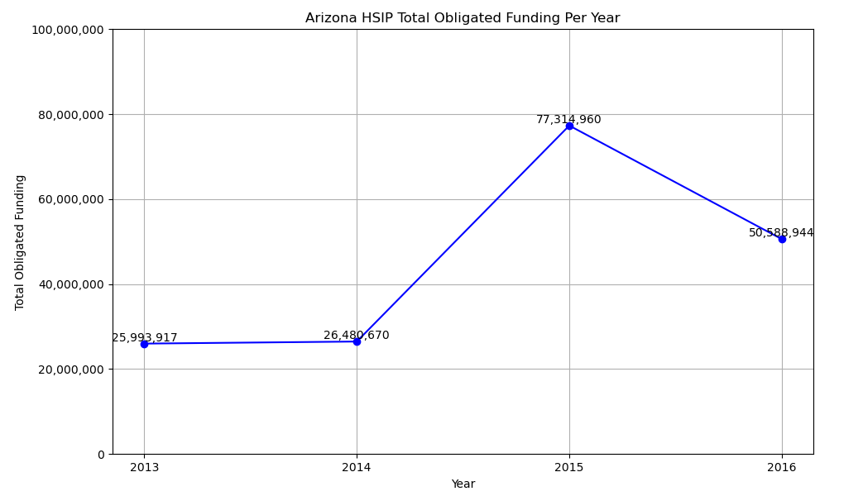
HSIP Funding
As shown in the graph, overall HSIP funding ranged from $25M-$77M per year.
The data shown reflects funding for 2013-2016 ranging from the year the program was put into place to the final year within the dataset of fatal accidents used to compare.

Slide 4
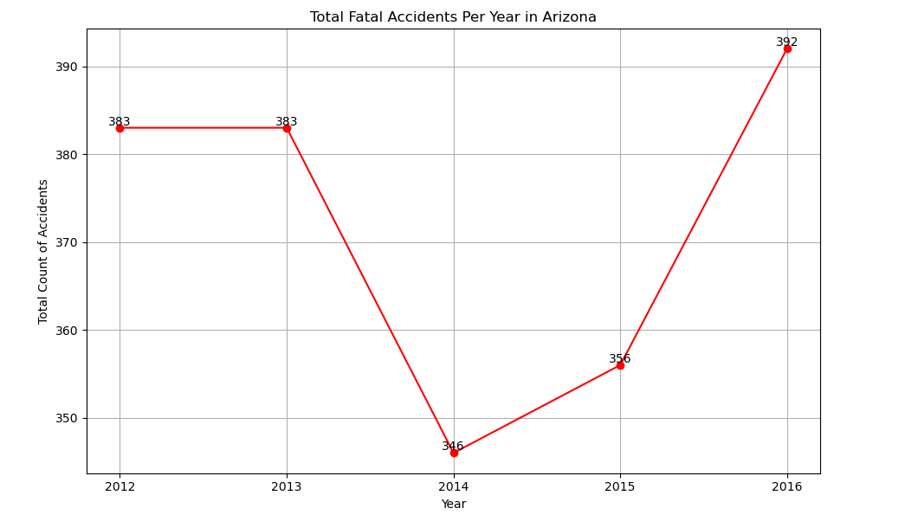
Total Fatal Accidents Per Year
The total # of fatal accidents per year took a dip between 2013-2014. This is the year that HSIP was put into place and received funding. When reviewing the two graphs, there’s an inverse relationship implying that the increases in funding might’ve played a part in the reduction of overall accidents.
Towards the end of the program’s initial term, the funding decreased. When the funding was reduced, the overall number of accidents began to rise again.

Slide 5
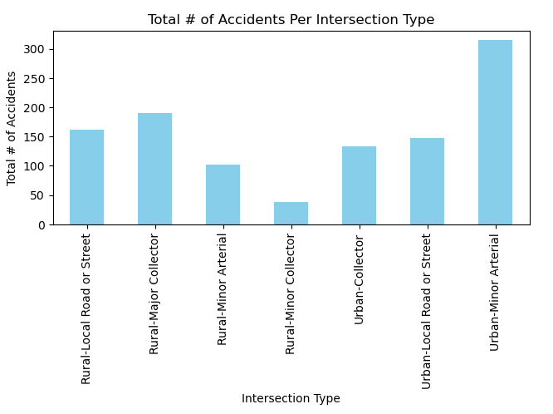
Intersection Review
When looking at the dataset of fatal accidents from 2012-2016, the most common type of roadway where accidents occurred were Urban-Minor Arterial roads. Urban-minor arterial intersections are roadways that are a step down from highways. These roads connect urban neighborhoods to the major highways.
There wouldn't be a way to limit this as these roadways are necessary for people living within a small urban area to navigate to other locations outside of their neighborhood.
For urban areas, collector streets have the least # of accidents within the dataset. It may be helpful to begin paving more collector streets that connect the arterials. This way, more people may avoid the arterials for a portion of their trip and only use it when necessary.

